Slide 1
DoBot
Samen Da Vinci

Slide 2
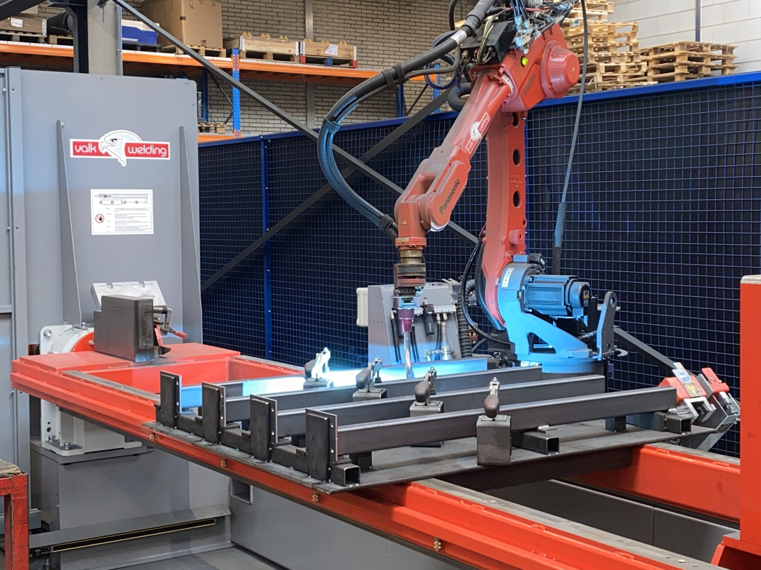
Robot armen bij assamblage

Slide 3
Waar worden robot armen gebruikt

Slide 4
Waar worden robot armen gebruikt
Assamblage
Lassen

Slide 5
Stages bij ontwikkelaars van robot oplossingen
Valk Welding – Alblasserdam
?? - Zwijndrecht
?? - Zwijndrecht

Slide 6
Introductie
01 Connecting Dobot Magician on Vimeo
02 Start up Dobot Magician on Vimeo
03 Start up DobotStudio on Vimeo

Slide 7
RO 1.1
04 Moving Joints on Vimeo
05 Angles of the joints on Vimeo
06 Moving in X, Y and Z on Vimeo
RO1.2
07 Writing and drawing on Vimeo
08 Teaching & Playback, motion styles on Vimeo
09 Programming & drawing letters on Vimeo
10 Drawing circels and circlebows on Vimeo

Slide 8
011 Mounting a suction cup on Vimeo
012 Starting with Dobotblock on Vimeo
13 Moving one block on Vimeo
14 Moving 3 blocks on Vimeo
15 Moving 3 blocks using a loop on Vimeo
16 Moving 3 blocks in a loop horizontaly on Vimeo
17 Place 3 cubes on top of each other using a loop. on Vimeo
18 Moving 9 cubes and stack them. on Vimeo
19 Moving nine cubes in a loop stacked vertically. on Vimeo

